Slide 1
De-identifying Data on the Fly, and Handling Imbalanced Datasets Using Synthetic Data Creation Using SMOTE-Synthetic Minority Oversampling Technique
Thomas Houze, Ph.D., M.Sc.
Notes:
I plan on making this a three-part presentation and discuss two topics wherein the first will be how Synthetic data provides an accepted means of dealing with privacy concerns when using sensitive data, and the second topic will concern how synthetic data can be used to remedy issues associated with small sample size, especially when associated with under-represented groups. I will give three means of accomplishing the above by providing examples of how to handle unbalanced data sets, such as the issue we have with our transgender population. I hope to have time at the end of my presentation to include a live demo of the application of Artificial Intelligence in solving the problems associated with unbalanced data sets using the Python programming language.
So please standby this should be both fun and interesting… ☺

Slide 2
An Exploration of the State of the Art
Nowadays, machine learning is widely employed to solve real-world problems, particularly in the medical and diagnostics fields.
However, training a machine learning model requires a massive amount of data, making it challenging due to the demand for access to medical data being rigid since the data is kept confidential, secure, and difficult to obtain.
Notes:
Nowadays, machine learning is widely employed to solve real-world problems, particularly in the medical and diagnostics fields.
However, training a machine learning model requires a massive amount of data, making it challenging due to the demand for access to medical data being rigid since the data is kept confidential, secure, and difficult to obtain.

Slide 3
Section-1 Part-I Data de-identification to Satisfy HIPPA and other Privacy Concerns
Notes:
A quick show and tell on how data synthesis and de-identify data on the fly and how it has satisfied all regulatory agencies
Part-1 is most relevant the community at large and I will attempt to demonstrate how synthetic data satisfies the requirements of all the major privacy organizations with references from the book titled "Practical Synthetic Data Generation" where the author refers to a "Privacy Assurance Certification"

Slide 4
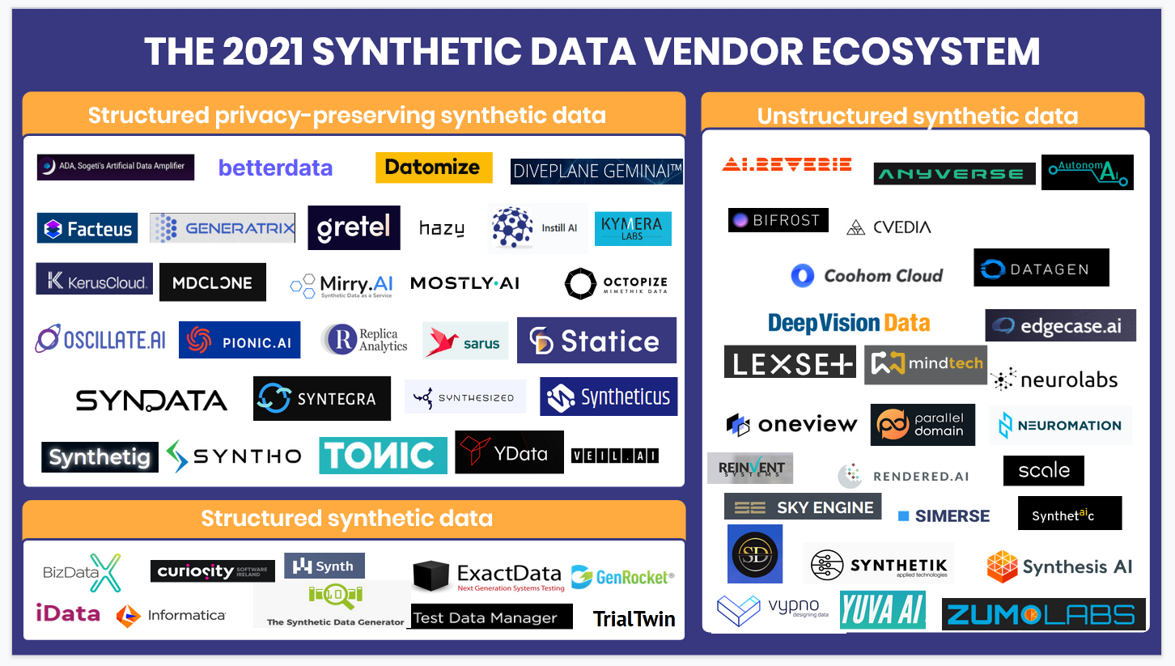
Notes:
And to prove my point here is a figure showing the number of US Start-up firms just from 2021 which specialize in the various application of synthetic data and this sector is expanding at a rate of 28% per year and it has been predicted in a report by the Gartner Consulting Company that the amount of synthesize data will exceed the amount of original data being used in data analytics by 2025. and the Synthetic Data Generation Market is projected to reach $1.79 Billion in annual revenues by 2030.

Slide 5
And you might the asking yourself why would any one want to use synthetic data?
The various applications of synthetic data in this sector is expanding at a rate of 28% per year and it has been predicted in a report by the Gartner Consulting Company that the amount of synthetic data will exceed the amount of original data used in data analytics by 60% by 2025. and the Synthetic Data Generation Market is projected to reach in annual revenues of $1.79 Billion by 2030.
Notes:
And you might the asking yourself why would any one want to use synthetic data?

Slide 6
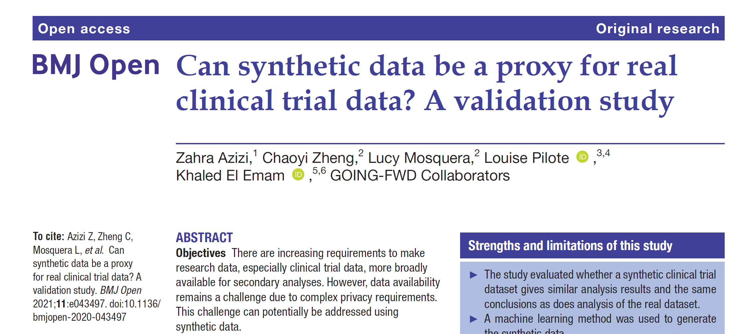
A pivotal paper published (see below) in 2021 by a research group trying to replicate the results of a clinical trial using synthetic data using synthetic data as a proxy for real data in the replication of a follow-up cancer clinical trial data?
And this methodology can certainly be applied to HIV-related data even allowing for sample amplification and augmentation on small sample sizes to make them useful for clinical research.

Slide 7
"Primary and secondary outcome measures Analyses from a study published on the real dataset were replicated on synthetic data to investigate the relationship between bowel obstruction and event-free survival. Information theoretic metrics were used to compare the univariate distributions between real and synthetic data. Percentage CI overlap was used to assess the similarity in the size of the bivariate relationships, and similarly for the multivariate Cox models derived from the two datasets."
Notes:
"Primary and secondary outcome measures Analyses from a study published on the real dataset were replicated on synthetic data to investigate the relationship between bowel obstruction and event-free survival. Information theoretic metrics were used to compare the univariate distributions between real and synthetic data. Percentage CI overlap was used to assess the similarity in the size of the bivariate relationships, and similarly for the multivariate Cox models derived from the two datasets."

Slide 8
Besides the fact that synthetic data can be used to amplify and augment existing small data sets and that synthetic data is usually of much better quality than the original data from which it was derived, synthetic data biggest advantage is that it is a “silver bullet” remedy to privacy concerns like HIPAA type regulations.
Notes:
Besides the fact that synthetic data can be used to amplify and augment existing small data sets and that synthetic data is usually of much better quality than the original data from which it was derived, synthetic data biggest advantage is that it is a “silver bullet” remedy to privacy concerns like HIPAA type regulations.

Slide 9
How Privacy Law Impacts the Creation and Use of Synthetic Data
Synthetic data offers a compelling solution to data sharing and data-access barriers, that is, a barrier that promotes greater scientific and commercial research while protecting individual privacy.
Synthetic data is different. It is not real data related to real people. There is no link between a synthetic dataset and records in the original (real) dataset.
If done properly, the creation of synthetic data should result in a dataset that cannot be reverse engineered to reveal identities of real people or information specific to a real person.
Notes:
This conclusion holds true even if the person using the synthetic dataset has or could gain access to the original dataset. That would not occur in most cases, since the key objective of creating synthetic data is to enable
the benefits of data use and analysis without giving access to real, personal data. Nevertheless, it may be worthwhile to have in place additional safeguards such as strong access controls on the original dataset, and
contractual prohibitions on any attempts to reverse engineer or link the synthetic data to the original data.

Slide 10
How the Use of Synthetic Data is About to Impact Privacy Regulations
If an organization does not have the capability and expertise to create synthetic data in-house, it may need to share the original (real) dataset with a service provider to create the synthetic data. That sharing is also likely to be subject to privacy law.
The creation and use of synthetic data is regulated under three key privacy laws: the European General Data Protection Regulation (GDPR),(1) the California Consumer Privacy Act (CCPA), (2) and the US Health Insurance Portability and Accountability Act (HIPAA) (3)
1. Regulation (EU) 2016/679 of the European Parliament and of the Council of 27 April 2016 on the protection of natural persons with regard to the processing of personal data and on the free movement of such data, and repealing Directive 95/46/EC (General Data Protection Regulation), 2016 O.J. (L 119) 1 (hereinafter “GDPR”).
2. California Consumer Privacy Act of 2018, Cal. Civ. Code §§1798.100-1798.199 (hereinafter “CCPA”).
3. Health Insurance Portability and Accountability Act of 1996, Pub. L. 104-191 (hereinafter “HIPAA”); Standards for Privacy of Individually Identifiable Health Information, 45 C.F.R. Parts 160 and 164 (hereinafter “HIPAA Privacy Rule”).
Notes:
If an organization does not have the capability and expertise to create synthetic data in-house, it may need to share the original (real) dataset with a service provider to create the synthetic data. That sharing is also likely to be subject to privacy law.
The creation and use of synthetic data is regulated under three key privacy laws: the European General Data Protection Regulation (GDPR),(1) the California Consumer Privacy Act (CCPA), (2) and the US Health Insurance Portability and Accountability Act (HIPAA) (3)

Slide 11
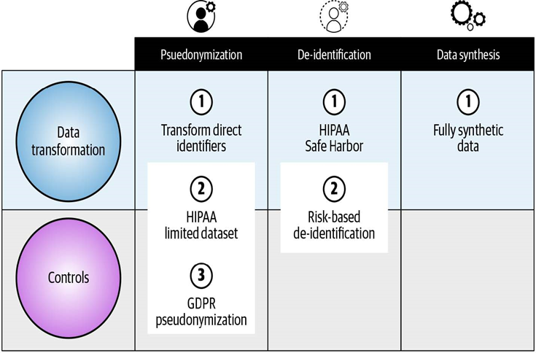
Figure 1
“There is of course a trade-off between cost and data utility. For example, implementing a high level of controls entails higher operational costs. This cost becomes more acceptable when the data utility achieved is also high (assuming that data utility is a priority to the organization). Of course, the ideal is when there is low operational cost and high data utility. While this is perhaps a simple view, ‘Figure 1’ illustrates some important trade-offs that an organization can make (4).”
4.Practical Synthetic Data Generation, K. El Eman et al, (2021) p.32. Chapter 2, Implementing Data Synthesis
Notes:
“There is of course a trade-off between cost and data utility. For example, implementing a high level of controls entails higher operational costs. This cost becomes more acceptable when the data utility achieved is also high (assuming that data utility is a priority to the organization). Of course, the ideal is when there is low operational cost and high data utility. While this is perhaps a simple view, ‘Figure 1’ illustrates some important trade-offs that an organization can make (4).”
4. Practical Synthetic Data Generation, K. El Eman et al, (2021) p.32. Chapter 2, Implementing Data Synthesis

Slide 12
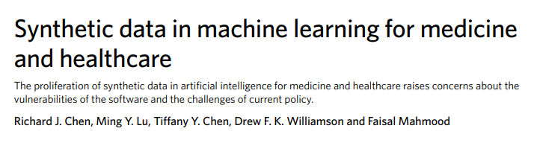

Slide 13
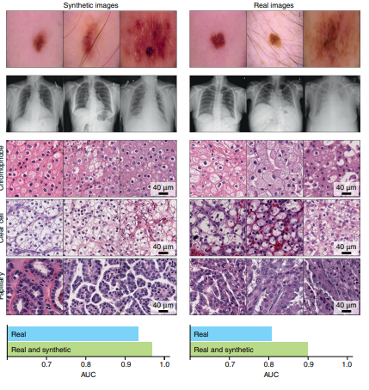
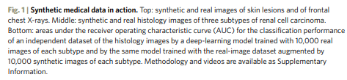
Notes:
Synthetic data is usually of better quality due to the augmentation process than the original data from which it is derived.

Slide 14
Evaluation metrics and human-in-the-loop tests
In addition to creating regulatory standards for synthetic-data quality, regulations and evaluation metrics should also be developed for models that assess not only realism but also failure modes, such as information leakage.
Although no consensus for a universal quantitative metric has been reached, recent discussions have pointed toward rethinking the evaluation of generative models as if facing a bias– variance trade-off — that is, models biased toward emulating only one label would fail to capture the multimodal nature of probability distributions, and models with high variance would generate data outside of the distributions.
This analogy gives rise to two qualities for scoring synthetic datasets:
Fidelity, for assessing the realism of synthetic samples; and diversity, for capturing the variability of real data.
The privacy issues in synthetic data can also define authenticity, a measurement of the number of copies of real data made by the model.
In experimentation with synthetic EMR data in the context of COVID-19, these three metrics were used to understand the fidelity–diversity and privacy–utility trade-offs in ranking generative models.
It was seen that prioritizing diversity and privacy-preserving performance decreased fidelity and downstream classification tasks using synthetic data.
Notes:
Evaluation metrics and human-in-the-loop tests
In addition to creating regulatory standards for synthetic-data quality, regulations and evaluation metrics should also be developed for models that assess not only realism but also failure modes, such as information leakage.
Although no consensus for a universal quantitative metric has been reached, recent discussions have pointed toward rethinking the evaluation of generative models as if facing a bias– variance trade-off — that is, models biased toward emulating only one label would fail to capture the multimodal nature of probability distributions, and models with high variance would generate data outside of the distributions.
This analogy gives rise to two qualities for scoring synthetic datasets:
Fidelity, for assessing the realism of synthetic samples; and diversity, for capturing the variability of real data.
The privacy issues in synthetic data can also define authenticity, a measurement of the number of copies of real data made by the model.
In experimentation with synthetic EMR data in the context of COVID-19, these three metrics were used to understand the fidelity–diversity and privacy–utility trade-offs in ranking generative models.
It was seen that prioritizing diversity and privacy-preserving performance decreased fidelity and downstream classification tasks using synthetic data.

Slide 15
Who knows what the future holds?
Notes:
Who knows what the future holds?

Slide 16
According to Gartner, by 2024, 60% of data utilized for developing A.I. and analytical projects will be synthetically generated, and consumption for A.I. projects will increase by 2030, whereby synthetic data would eventually supplant actual data in A.I. models (5).
5. White, A.(2022). By 2024, 60% of the data used for the development of A.I. and analytics projects will be synthetically generated - Andrew White.
Notes:
According to Gartner by 2024, 60% of data utilized for developing A.I. and analytical projects will be synthetically generated, and consumption for A.I. projects will increase by 2030, whereby synthetic data would eventually supplant actual data in A.I. models as shown in Figure 1.
Figure 1. Synthetic Data will replace actual data in A.I. models by 2030 [2]

Slide 17
Section-2 How to handle an Imbalanced Data Set An imbalanced data set is a data set where the number of members of the majority class far outnumbers the number of members of the minority class.
Notes:
How to handle an Imbalanced Data Set An imbalanced data set is a data set where the number of members of the majority class far outnumbers the number of members of the minority class.

Slide 18
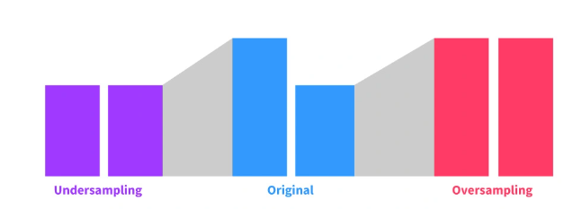
Part-1 Under-sampling (Not very popular)
Notes:
In the first (left most) instance we see the final affect of undersampling were one pull all the rare events while also pulling small sample of the abundant events to equalize the databases. This means of data analysis is not very popular because one must reduce the number of data points for the dominant data category to match the number of data points for the dominant data category and in data science the more data you have the better so anything that makes you reduce the amount of data that you have is problematic and not desirable . In the middle is a more common occurrence and unbalanced data set where the sample will contain a multiple of relative abundances but in this case let's say that we are looking at an abundant data set and a rare data set.
And the last example on the far right is an example of oversampling where a rare database will be amplified and even augmented so that the number of samples of the rare data will have the same relative abundance as the more abundant data and therefore the data set will be balanced and the rare data or not be biased by the relative abundance of the common or more abundant data.

Slide 19
Three Means of Balancing an Imbalanced Data Set
Notes:
Three Means of Balancing an Imbalanced Data Set

Slide 20
Part-2 Oversampling: the best and most accurate method but time consuming and expensive
NB: Please note that expensive is a relative term. ☺
Notes:
My aim is to demonstrate how synthetic data can be used to balance an unbalanced data set by amplifying random sampling of 33% of the minority (target) data set three times with replacement.
Please note that it is vital that we are always working with totally randomized samples so that we have a shuffled deck of randomly "mixed cards“ just as if you were playing a game of chance to prevent bias, where the samples are hopefully "representative" of the entire population, which is never really the case for every possible attribute in a population, and so that samples are randomly distributed to reduce sampling bias.
Each sampling (aliquot) is returned to the original sample which is then re-randomization before another cycle of amplification is performed so that with replacement the sample used in the subsequent amplification has the same sample composition as the original sample following re-randomization.

Slide 21
Part-3 SMOTE - Synthetic Minority Oversampling Technique
The most important and impressive, in my opinion, is a demo of the power of Python programming language applying the Synthetic Minority Oversampling Technique (SMOTE), which does not require data synthesis but rather uses a powerful Machine Learning method using the Python Sklearn and Pandas Libraries to perform ML on a sample data set.

Slide 22
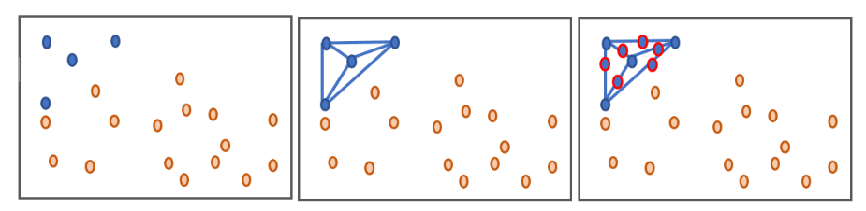
SMOTE
Amplification of the minority class instances till the number of majority class instances to prevent
Overfitting of the prediction model to the majority class
1. https://datasciencecampus.github.io/balancing-data-with-smote/
Notes:
Using the SMOTE technique, we generate data.
Let’s say that the dots in the above illustration represents various data points where we have two Classes.
The Blue color is not Cancer, and the Red color is Cancer.
So, let’s say that the Red Class is initially much smaller than Blue Class, making it very difficult to predict the Red or Cancer Class elements.
So, what SMOTE will do, which is illustrated above in the box is take SMOTE will take the distance to the nearest neighbors of any members of the Minority (RED) Class and then take the average of those nearest neighbors and predict the plausible location of where another member of the Minority (Red) Class would be found and then use that information to create and new Red class member until the number of Minority Class members is equal to the number of Majority Class members.

Slide 23
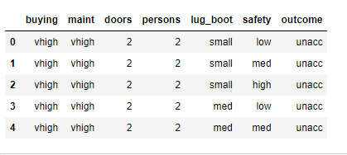
Notes:
I will attempt to demonstrate the use of SMOTE and how it can be used to balance data sets.
Next, I will quickly show how you do it with a real data set, so now that you understand the concept, I can show you the Python code part.
I have a data set called car evaluation, a data set of 1728 records with seven columns containing data attributes.
This data is from the UCI Data Repository.
Let me quickly explain this data to you; this data describes in the “outcome” column of the data set, which is the evaluation (y-value) of a car model as being “acceptable” or “unacceptable” by a consumer affairs orientated magazine based on the six variables in the columns of the dataset which are “buying cost,” “maintenance cost,” “the number of doors,” the “number of persons that the car can hold,” the “size of the trunk ‘luggage boot’ of the car,” and the “safety rating of the car.”
The ratings of the car model are rated regarding safety as low, medium, and high, and in terms of outcome, the car models are rated as “acceptable” or “unacceptable.”
If you were to look at the number of records of each of the classes, you would see that out of the 1728 car models, 1210 of the records belong to the “unacceptable class,” 384 of the models belong to the “acceptable class,” 69 of the models belong to the “good cars class,” and 65 of the models belong to the “very good class.”
So, you can see that this is an example of an imbalanced data set in that the “minority class” for “very good” cars and “good cars” have 65 and 69 members, respectively. Thus, both data sets are about 19 times smaller than the “majority class,” so it can be said that the majority class is about 19 times bigger than the minority classes.
So now I use the Sklearn software to preprocess and classify the data by first removing the values of the last column and then re-labeling the data so that the algorithm can process it.

Slide 24
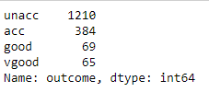

Slide 25
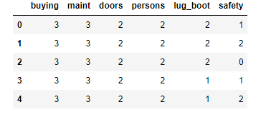

Slide 26
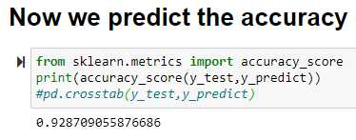

Slide 27
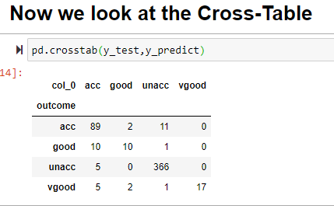
Predictions
89/102 = 87%
Actual Values
10/21 = 67%
366/571 = 98%
17/25 = 68%
Notes:
You can clearly see that the majority class has a huge advantage in the accuracy (98%) of its predictions when compared to the Minority Classes wherein the case of “Good” and “Very Good” car models only have a predictive accuracy of 67% and 68%.

Slide 28
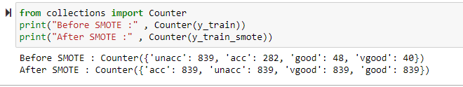
Get SMOTE!
Notes:
Get SMOTE!
Before SMOTE-ing, the classes had the following numbers Unacceptable 839, Acceptable 282, Good 48, and Very Good 40, AND after SMOTE-ing, all the classes have the same number of members as the Majority class.
How did this happen? This happened because the SMOTE algorithm performed extrapolation on all the individual classes, effectively amplifying them so that they have the same number of members at the Majority Class.
So what the software does is that it looks at the nearest neighbors to each of the members of the various Classes and takes the average of the neighboring data and uses this value to create new data

Slide 29
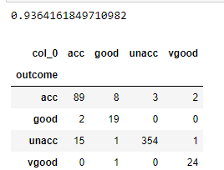
Predictions
89/102 = 87% (87%)
19/21 = 90% (67%)
Actual Values
354/371 = 95% (98%)
24/25 = 96% (68%)
Notes:
As you can see, the accuracy went up, which is great but what is much more important is that you can see notable changes in the predictive accuracy of all the Classes.
As you can see the accuracy of the predictions of the Minority Classes have gone from 67% and 68% to 90% and 96% due to the SMOTE-ing of there data sets which now put them into a reasonable range of predictive accuracy.
One might notice that the predictive accuracy of the Majority Class has taken a slight hit as a result of the SMOTE-ing process where it has gone from 98% down to 95% but that is the price that one pays for the SMOTE-ing process.

Slide 30
Our sample Classes now have a predictive accuracy between 87% and 96%. In contrast, before, the Minority Classes only had a predictive accuracy of 67% and 68%.
Which is a vast improvement in the predictive accuracy of the Minority Classes,
Class Before After
Acceptable 87% 87%
Good 67% 90%
Unacceptable 98% 95%
Very Good 68% 96%
Which in our HIV-related studies would be the data that, for instance, might belong to an under-represented population like the transgender population.
Notes:
So, look at this: all our Classes now have a predictive accuracy between 87% and 96%. In contrast, before, the Minority Classes only had a predictive accuracy in the upper sixty present range, and now have a predictive accuracy of 90% and 96%, which is a vast improvement in the original predictive accuracy of the Minority Class before treatment with SMOTE, which in our HIV-related studies would be the data that, for instance, might belong to and under-represented population like the transgender population.

Slide 31
CONCLUSION
Notes:
I have attempted to demonstrate how predictive analytics can be performed using data science techniques for the accurate prediction of patterns even in small data sets which is a common occurrence when trying to study data from underrepresented populations.
The above was accomplished with a demo of the power of Python programming language applying the Synthetic Minority Oversampling Technique (SMOTE) which does a form of data synthesis a powerful Machine Learning method
Python was applied with a few keystrokes to clean and balance a data set with about 2000 rows in an instant after using Python.
The application of SMOTE on the data set increases the predictive accuracy of the two Minority Classes, that is, under-represented data in the sample data set from about 67% and 68% to about 90% and 96%, with only a slight hit taken in the predictive accuracy of the Majority data set as a statistical trade off when using SMOTE were using Python in the Jupyter Notebook environment makes doing the above seem relatively easy.

Slide 32
Questions & Answers

Slide 33
Thank You
Notes:
Thank you, and let’s please hope that the benefits of synthetic data will allow us to please put one more nail in the coffin of HIV and its dreaded comorbidities because I am excited about its potential.

